Slide 1
NETY Project
Isaac (2100902B) | Jordan (2102250D) |
Chee Hsien (2100342A) | Jonas (2100439E) |

Slide 2
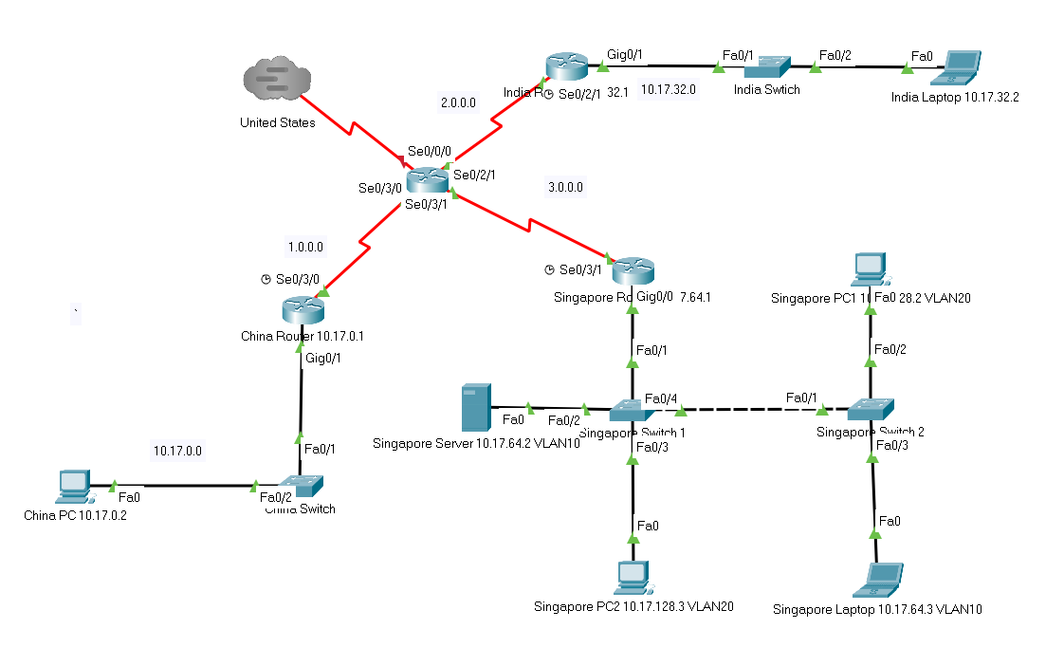
Overview of Network Topology

Slide 3
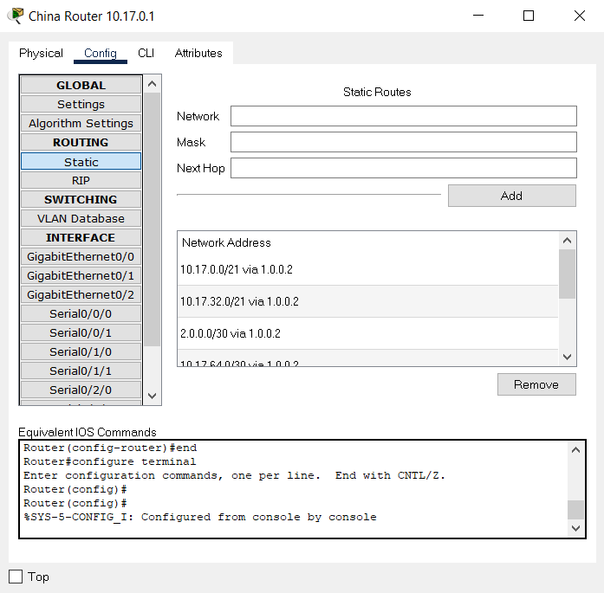
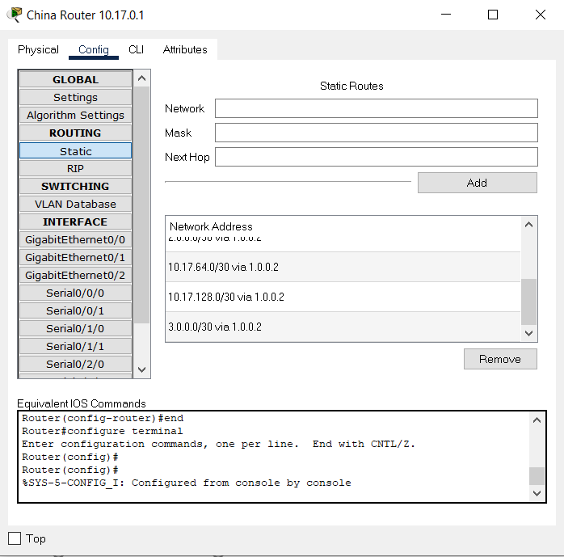
Configurations for China Router (static)

Slide 4
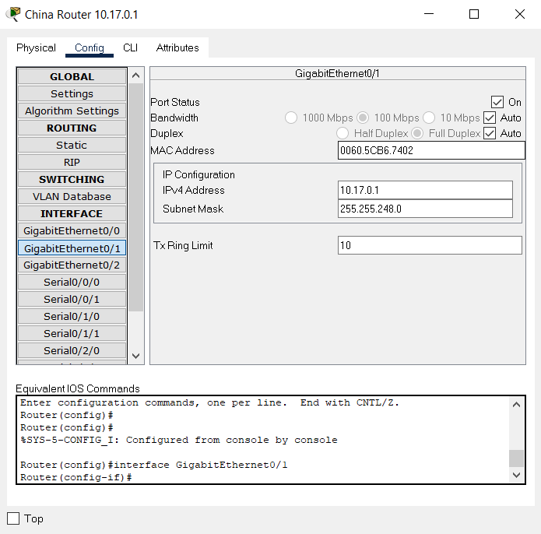
Configurations for China Router (g0/1)

Slide 5
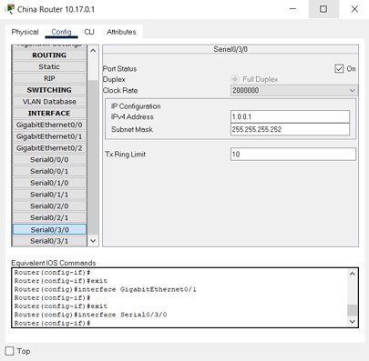
Configurations for China Router (s0/3/0)

Slide 6
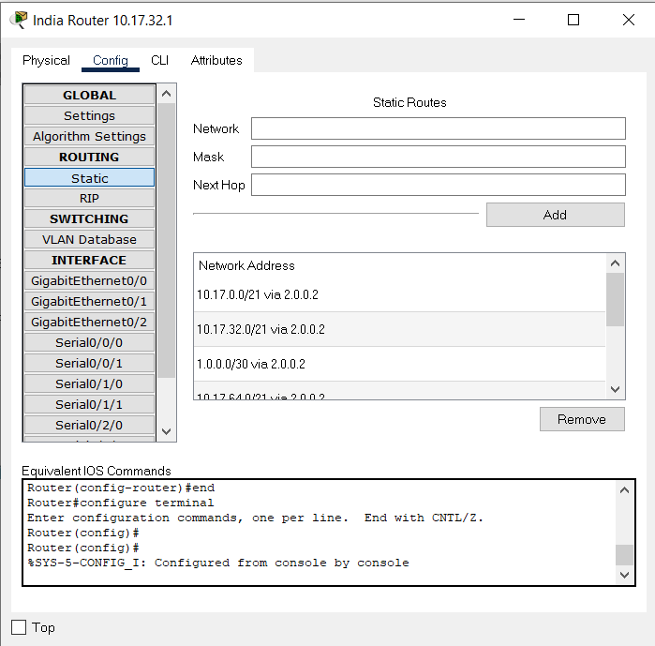
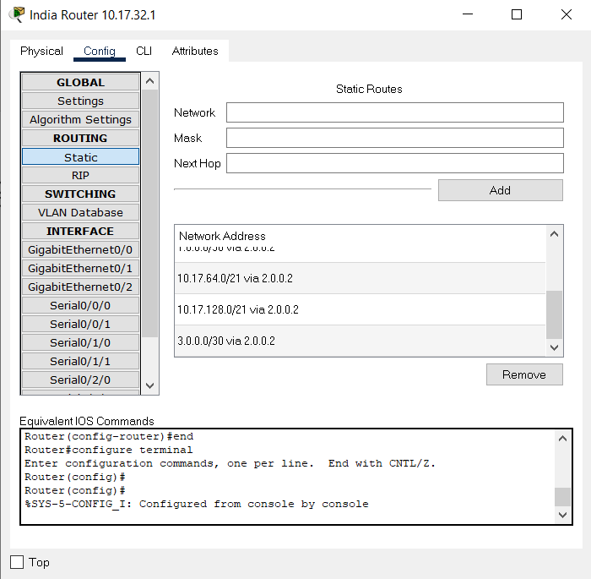
Configurations for India Router (static)

Slide 7
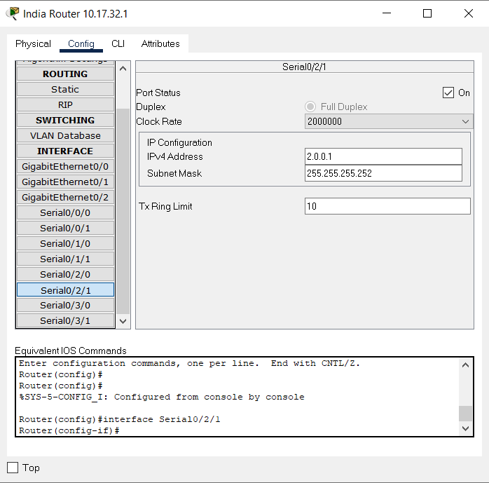
Configurations for India Router (s0/2/1)

Slide 8
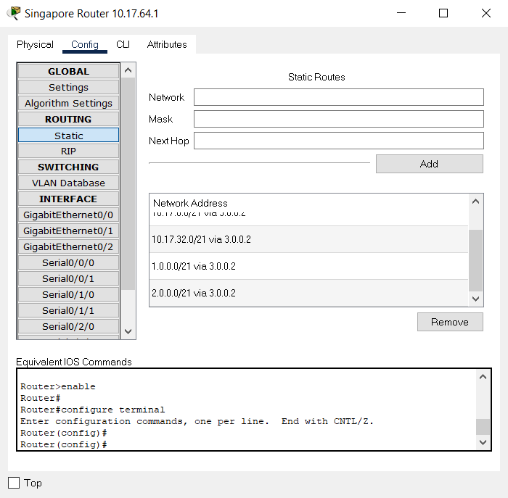
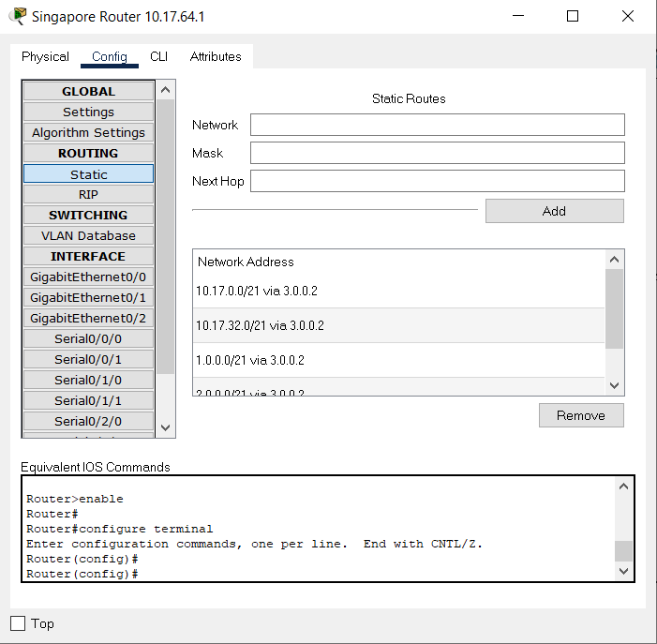
Configurations for Singapore Router (static)

Slide 9
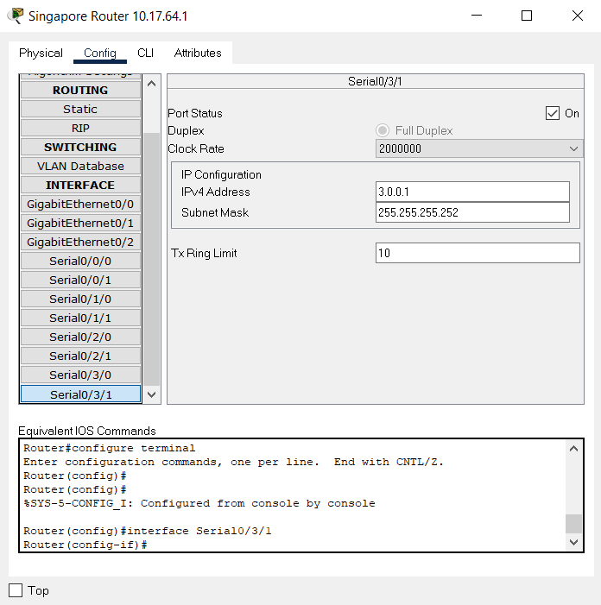
Configurations for Singapore Router (s0/3/1)

Slide 10
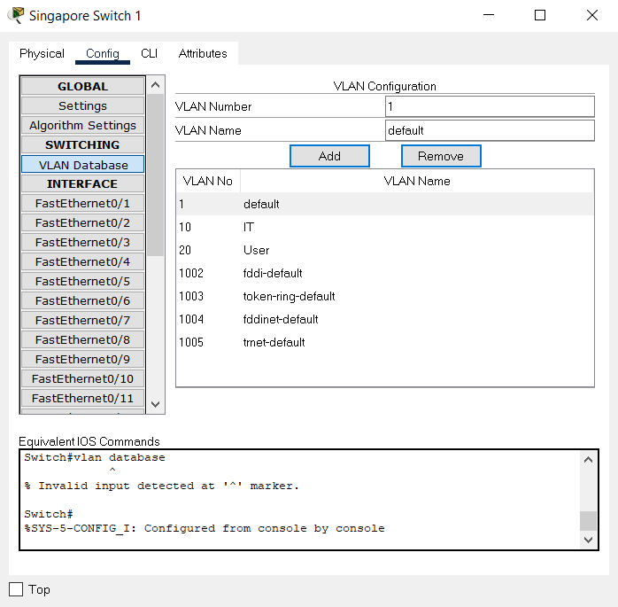
Configurations for Singapore Switch (Switch 1 VLAN)

Slide 11
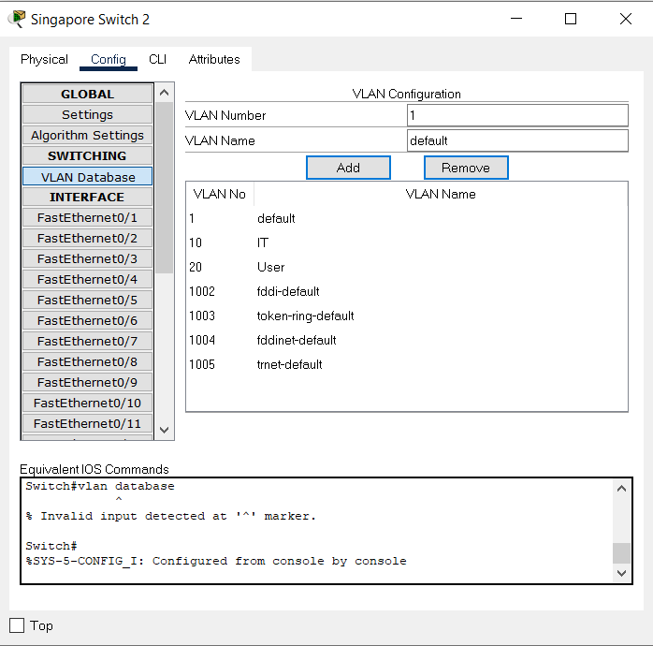
Configurations for Singapore Switch (Switch 2 VLAN)

Slide 12
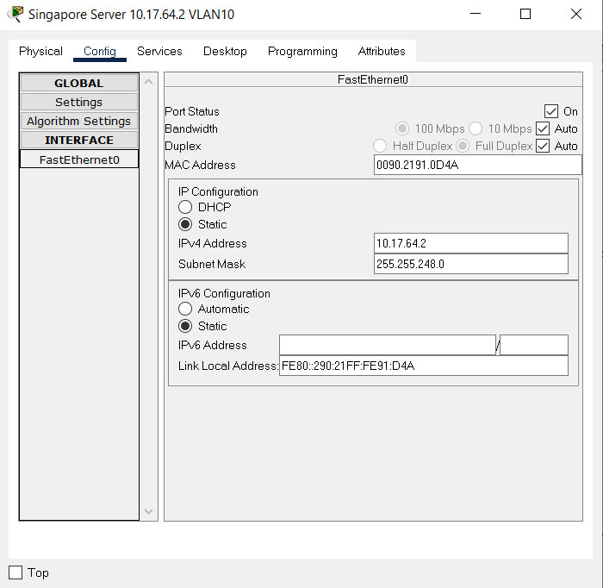
Configurations for Singapore Server

Slide 13
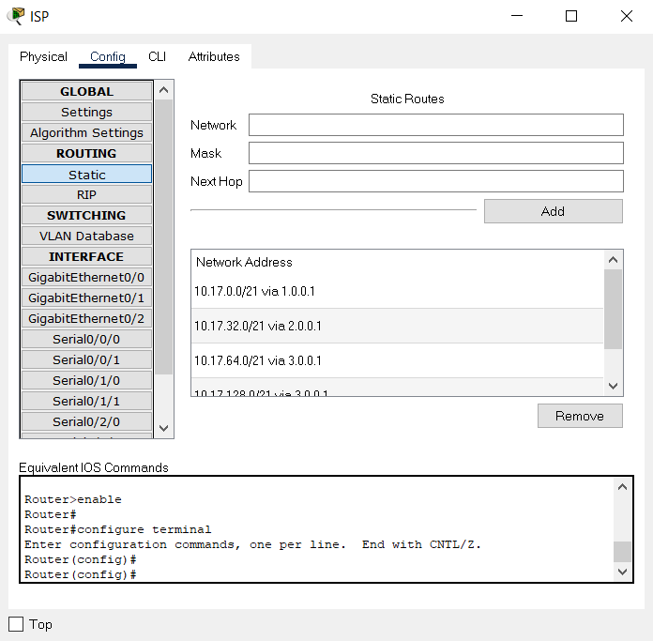
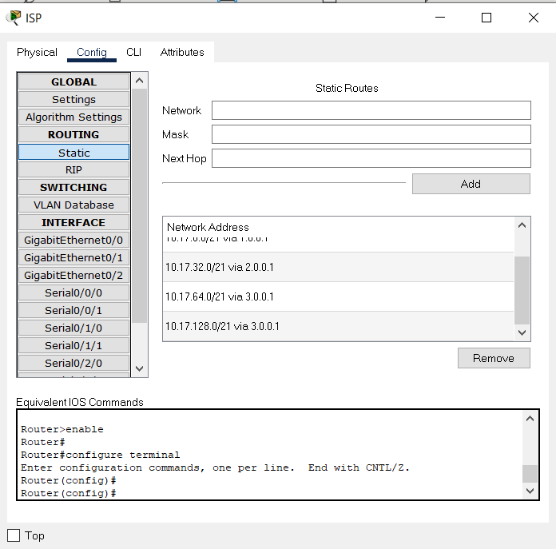
Configurations for ISP Router (static)

Slide 14
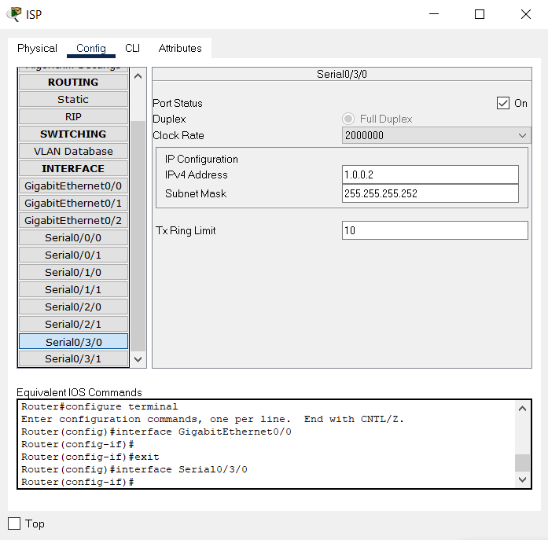
Configurations for ISP Router (s0/3/0, ISP to China)

Slide 15
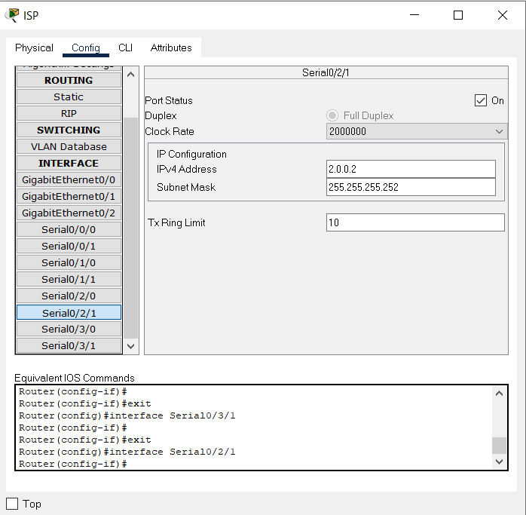
Configurations for ISP Router (0/2/1, ISP to India)

Slide 16
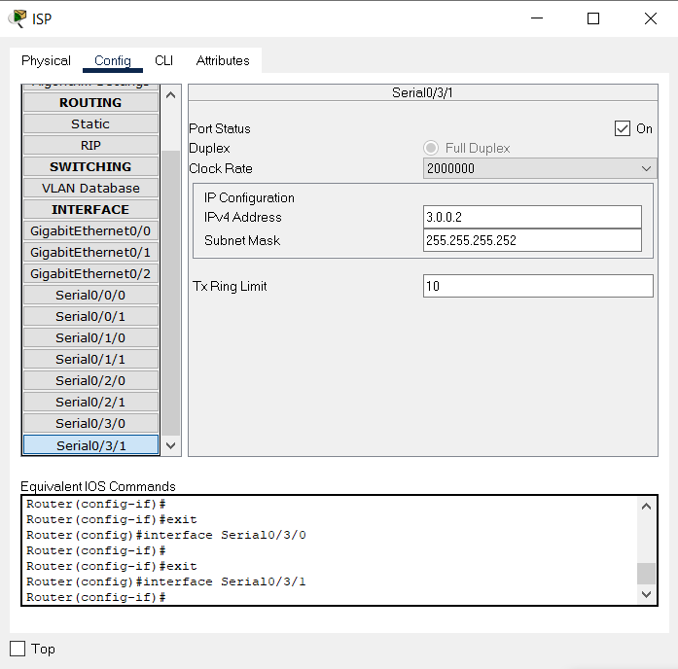
Configurations for ISP Router (s0/3/1, ISP to Singapore)

Slide 17
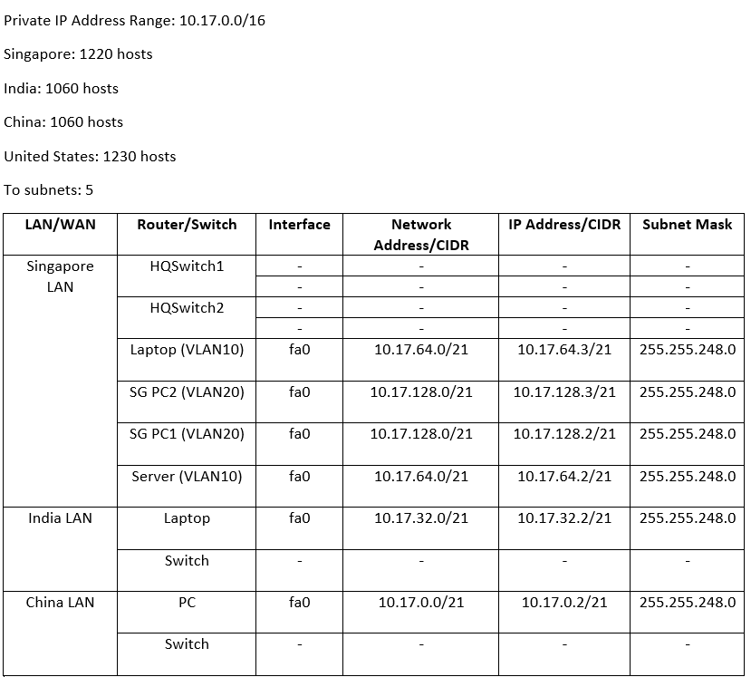
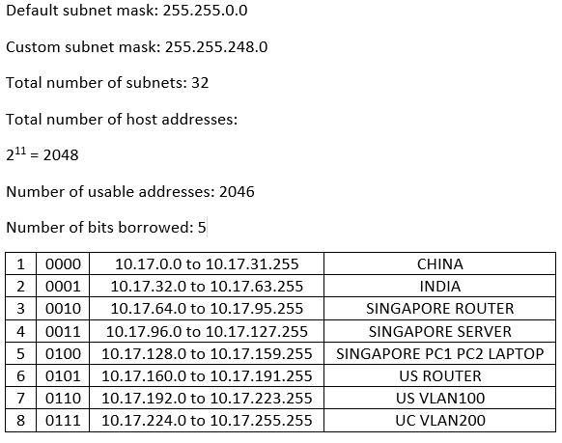
IP Addressing Table

Slide 18
ISP Router
Countries | Serial port | IP Address | Network address
China to ISP | s0/3/0 | 1.0.0.2/30 | 1.0.0.0
India to ISP | s0/2/1 | 2.0.0.2/30 | 2.0.0.0
Singapore to ISP | s0/3/1 | 3.0.0.2/30 | 3.0.0.0
United State to ISP | s0/0/3 | 4.0.0.2/30 | 4.0.0.0
China Router
Countries | Serial Port | IP Address | Network address
Gateway | s0/3/0 | 10.17.0.1 | 10.17.0.0
China to ISP | s0/3/0 | 1.0.0.1/30 | 1.0.0.0

Slide 19
India Router
Countries | Serial Port | IP Address | Network address
Gateway | s0/2/1 | 10.17.32.1 | 10.17.32.0
India to ISP | s0/2/1 | 2.0.0.1/30 | 2.0.0.0
Singapore Router
Countries | Serial Port | IP Address | Network address
Gateway | s0/3/1 | 10.17.64.1 | 10.17.64.0
Gateway | s0/3/1 | 10.17.128.1 | 10.17.128.0
Singapore to ISP | s0/3/1 | 3.0.0.1/30 | 3.0.0.0

Slide 20
Types of static routing protocol used
For all routers, we configured directly attached static route from each router to the other.
From China Router, we connected it to the India router's IP Address and used China Router's serial port as the exit interface.
We then repeated the steps for India and Singapore routers.
We also used the encapsulation and trunking method for the Singapore network and created VLANS for the Singapore devices.
Assumptions made were:
The assigned IP Address were all assumed, based on the IP addressing table

